Slide 1
Collections

Slide 2
Overview
There are many different kind of collections in real world: collection of books, CDs, pens, cup from all over the world,….
So many places to store them: book shelves, boxes, …
The same in Python!
The main idea – all they are sequences…
­A ­sequence - is a succession of values that­ are bound ­together ­in ­a ­container (list, string).
No ­matter­ which­ sequence­ you­ use, ­they ­all support­ two­ functions:­ index() and count().

Slide 3
Type of Collections
Tuple: A tuple is a collection used to create complex list-like sequences. An advantage of tuples is that you can nest the content of a tuple. This feature lets you create structures that can hold employee records or x-y coordinate pairs.
Dictionary: As with the real dictionaries, you create key/value pairs when using the dictionary collection (think of a word and its associated definition). A dictionary provides incredibly fast search times and makes ordering data significantly easier.
Stack: Most programming languages support stacks directly. However, Python doesn’t support the stack, although there’s a work-around for that. A stack is a last in/first out (LIFO) sequence. Think of a pile of pancakes: You can add new pancakes to the top and also take them off of the top. A stack is an important collection that you can simulate in Python by using a list.

Slide 4
Type of Collections
queue: A queue is a first in/first out (FIFO) collection. You use it to track items that need to be processed in some way. Think of a queue as a line at the bank. You go into the line, wait your turn, and are eventually called to talk with a teller.
deque: A double-ended queue (deque) is a queue-like structure that lets you add or remove items from either end, but not from the middle. You can use a deque as a queue or a stack or any other kind of collection to which you’re adding and from which you’re removing items in an orderly manner (in contrast to lists, tuples, and dictionaries, which allow randomized access and management).

Slide 5
Tuples

Slide 6

Overview
A ­tuple ­is ­a ­collection ­used ­to ­create ­complex lists;
You can embed one tuple within another => hierarchies;
The idea is that­ you ­can ­create­ complex ­data structures ­by ­using ­a ­tuple;
Tuples are immutable, which means you can’t change them.
Is it advantage OR disadvantage?

Slide 7
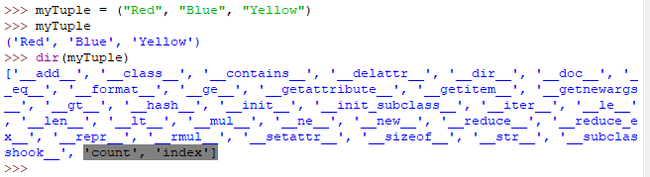
Creation
Available functions
Main ones
Add????
You can add new items by using the __add__() function. See later on ….

Slide 8
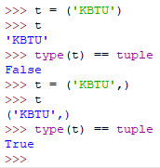
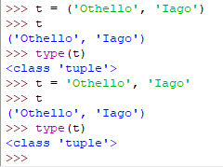
Some details
String
What is the difference?
Tuple
Extra comma isn’t necessary for two items, even parenthesis ….!

Slide 9
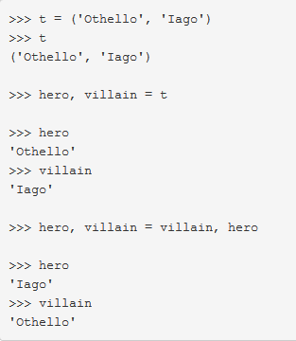
More details
Unpacking
Swapping variables

Slide 10

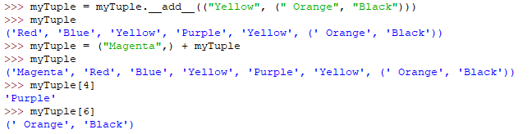
ADDITION
You can only concatenate tuple (not "str") to tuple
A new copy of myTuple. The old copy of myTuple is destroyed after the call.
Hierarchy
Concatenation
Indexing

Slide 11
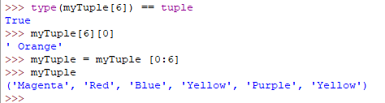
Checking the hierarchy object
The indexes always appear in order of their level in the hierarchy.
To remove an element from a tuple
Using a combination of indexes and the __add__() function (or the concatenation operator, +), you can create flexible applications that rely on tuples.

Slide 12
When to Use Tuples?
When you need to store data that doesn't have to change.
When the performance of the application is very important. In this situation you can use tuples whenever you have fixed data collections.
When you want to store your data in logical immutable pairs, triples etc.

Slide 13
Dictionaries

Slide 14
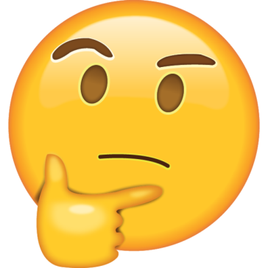
Overview
Similar to real world dictionaries;
Dictionary order is undefined and implementation-specific. It can be different across interpreters, versions, architectures, and more. Even multiple executions in the same environment.
Dictionaries are mutable;
The main reason to use a dictionary is to make information lookup faster;
The ­key ­is ­always ­short ­and ­unique;
Does dictionary remained you another statement?

Slide 15

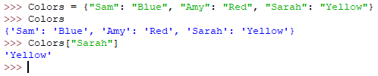
Other method of creation
The key must be unique.
The key must be immutable
any Python object
the color associated with Sarah
Using a string as a key, rather than using a numeric index, makes the code easier to read and makes it self-documenting to an extent.
By making your code more readable, dictionaries save you considerable time in the long run (which is why they’re so popular).
However, the convenience of a dictionary comes at the cost of additional creation time and a higher use of resources, so you have trade-offs to consider.

Slide 16
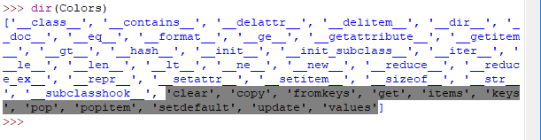
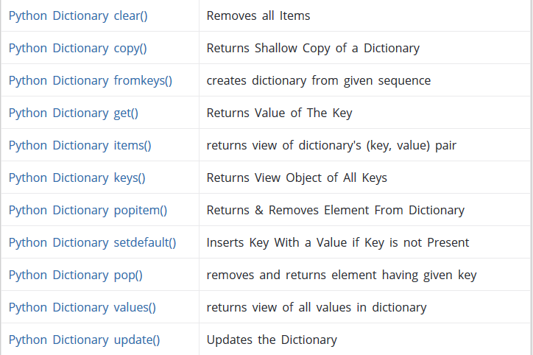
Built-in methods

Slide 17
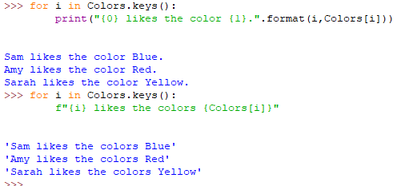
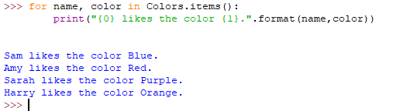
Outputting a list of each of the user names and the user’s favorite color:
1st method
2nd method
Built-in function
3rd method

Slide 18
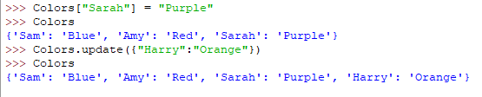
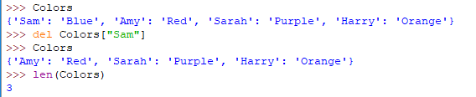

Changing the value
Adding new item
Deleting an item
The length of dictionary
Clearing the whole dictionary

Slide 19
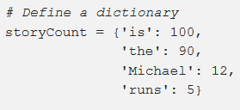

get method
The get method returns a value for a given key. If a key doesn’t exist, the dictionary will by default return None.

Slide 20
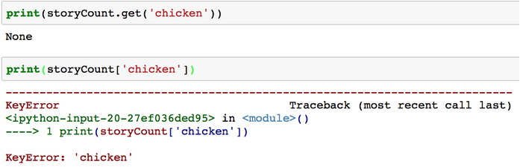
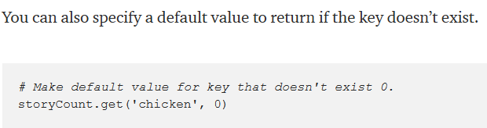
More about GET method
The method is very useful to look up keys you don’t know are in the dictionary to avoid KeyErrors.

Slide 21
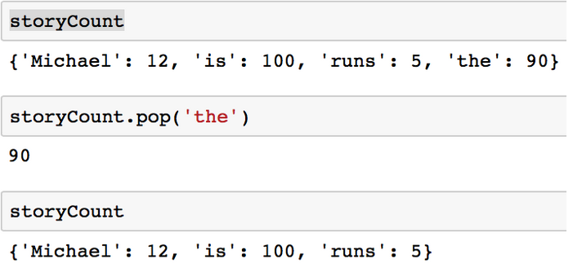
pop Method
The pop method removes a key and returns the value.
If the specified key exists
If <key> is not in d, and the optional <default> argument is
specified, then that value is returned, and no exception is raised:
storyCount.pop('z', -1)

Slide 22
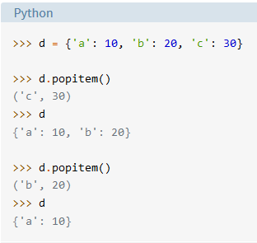
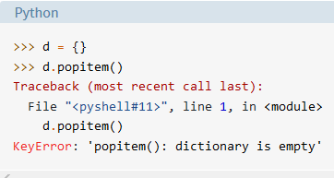
Popitem method
popitem() removes, arbitrary key-value pair from d and returns it as a tuple:

Slide 23
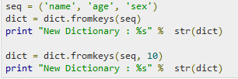

fromkeys() method
Creates a new dictionary with keys from seq and values set to value.
dict.fromkeys(seq[, value])
would be used for dictionary values
would be used for dictionary keys

Slide 24



Setdefault() method
Returns the key value available in the dictionary and if given key is not available then it will return provided default value.

Slide 25
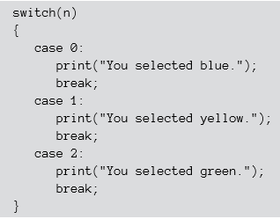
SWICH STATEMENT vs DICTIONARY
Suppose, the user have to choose one color.
The most elegant way to represent it in other languages:
But, in Python it won’t execute…..

Slide 26
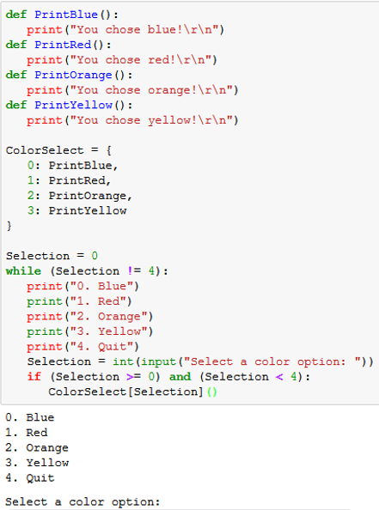
SWICH STATEMENT vs DICTIONARY
Simple functions
Dictionary
Main
Output

Slide 27


Combination of tuples and dictionary
takes n lists and returns one list of n-tuples.

Slide 28
When to Use a Dictionary?
When you need a logical association between a key:value pair.
When you need fast lookup for your data, based on a custom key.
When your data is being constantly modified. Remember, dictionaries are mutable.

Slide 29
Queues

Slide 30


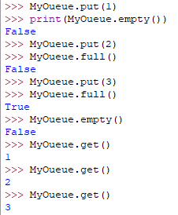
Working with queues (FIFO)
import the queue package
Is it empty or not?
Insert an item into a queue
Is it full or not?
Get item from the queue

Slide 31
deques
A deque is simply a queue where you can remove and add items from either end.

Slide 32
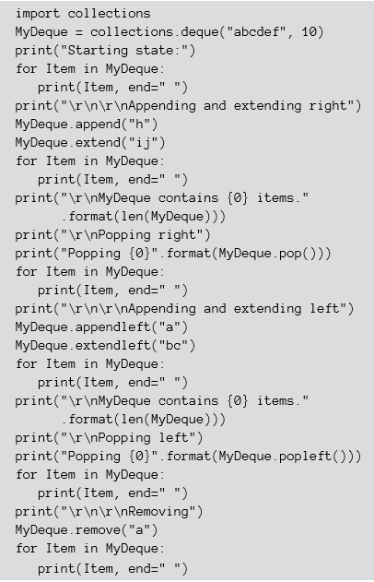
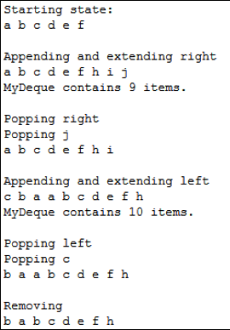
Working with deques
Starting list
Max size
Iteration through dequeue
append() or appendleft() when adding a single item;
extend() and extendleft() functions let you add multiple items;

Slide 33
Working with deques
pop() or popleft() functions to remove one item at a time;
remove() function is unique in that it always works from the left side and always removes the first instance of the requested data.

Slide 34
References
https://www.programiz.com/python-programming/methods/dictionary
https://www.programiz.com/python-programming/dictionary
https://www.programiz.com/python-programming/tuple
https://www.pythoncentral.io/use-queue-beginners-guide/

